Slide 1


Unit 4: Lesson 12 What’s on TV?
U ovoj ćemo lekciji:
govoriti televizijskim emisijama
učiti kako nešto predložiti
odglumiti prizor iz TV emisije

Slide 2


Slide 3


Slide 4
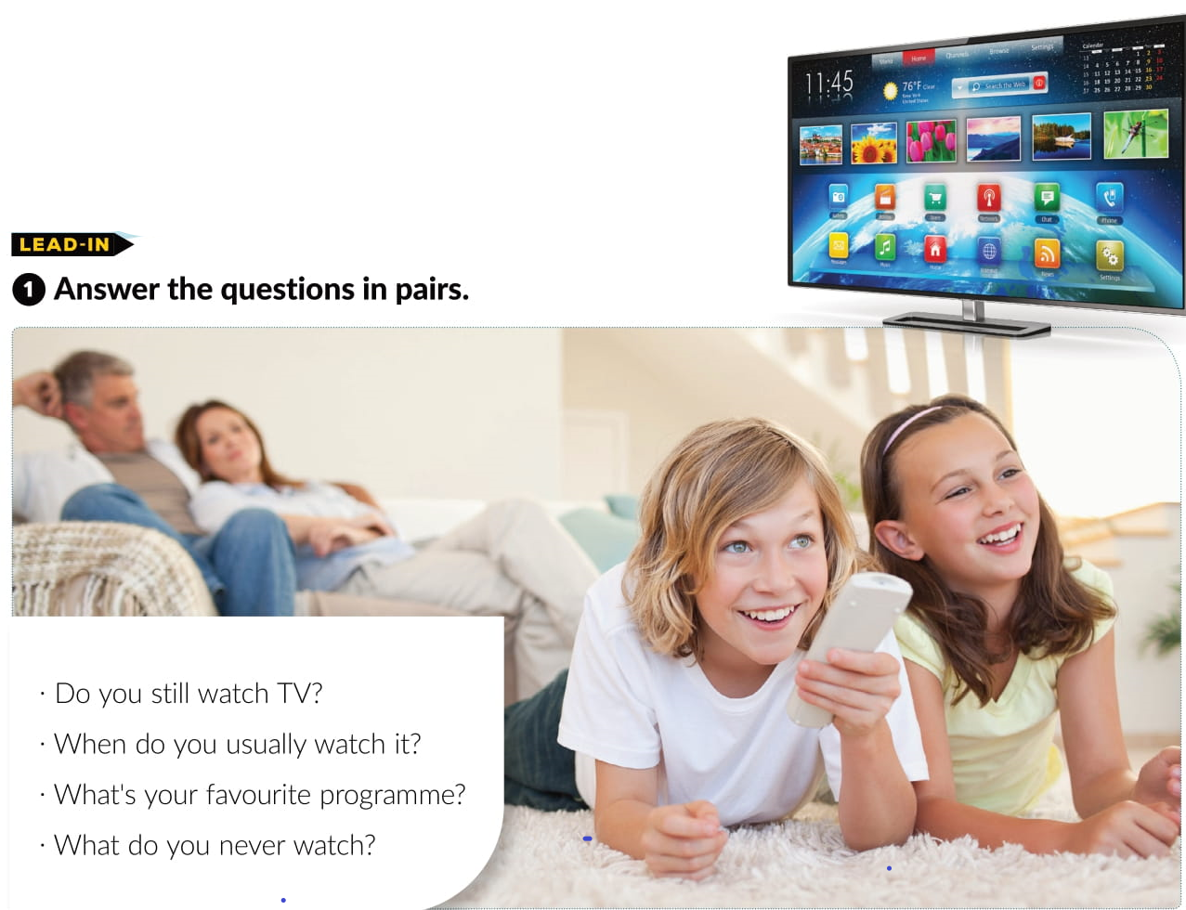
Textbook, p.76

Slide 5
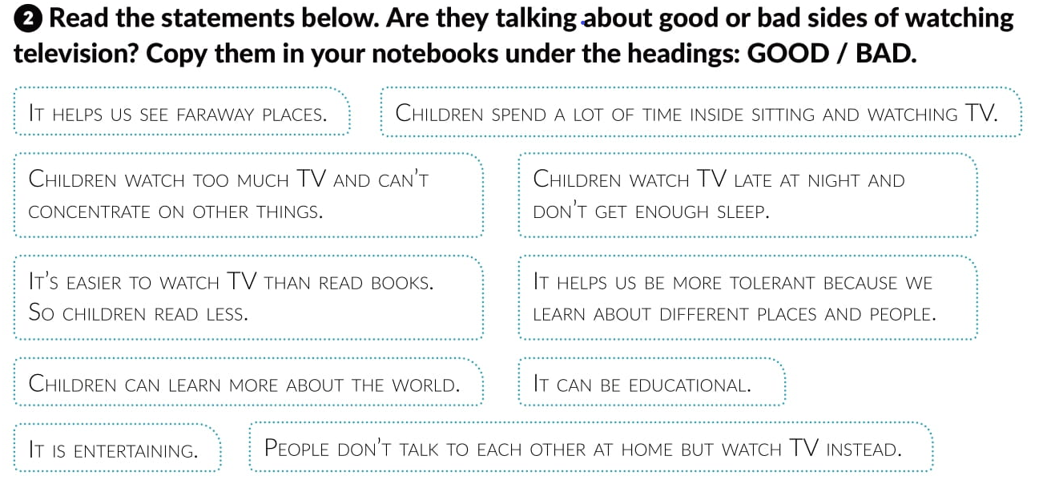
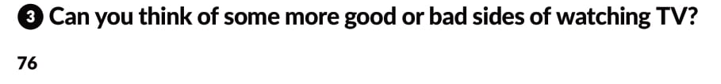

Slide 6
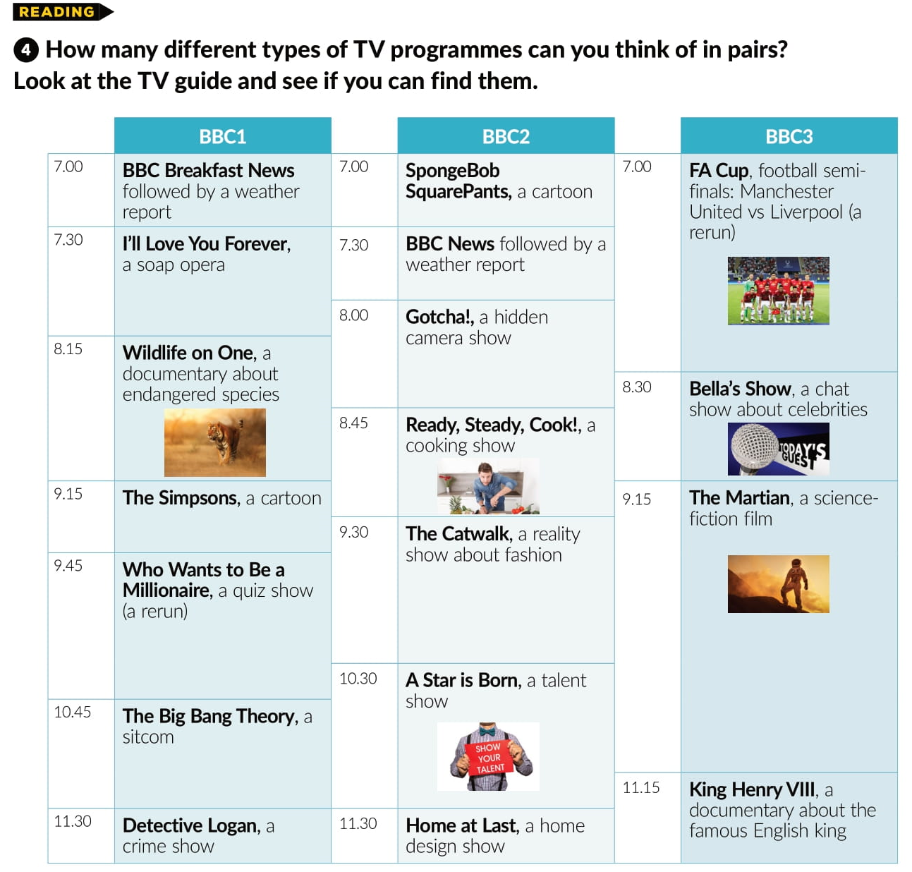


Slide 7
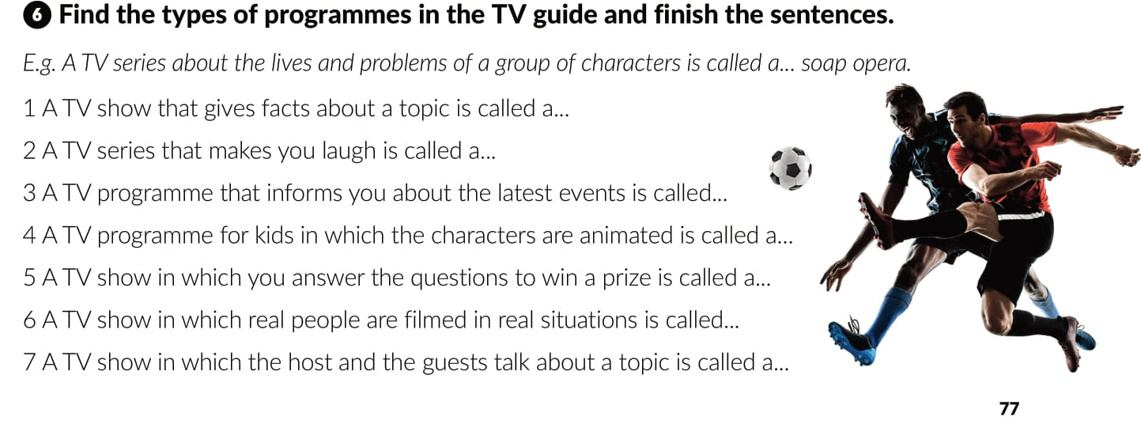
documentary
sitcom
news
cartoon
quiz show
reality show
chat show

Slide 8
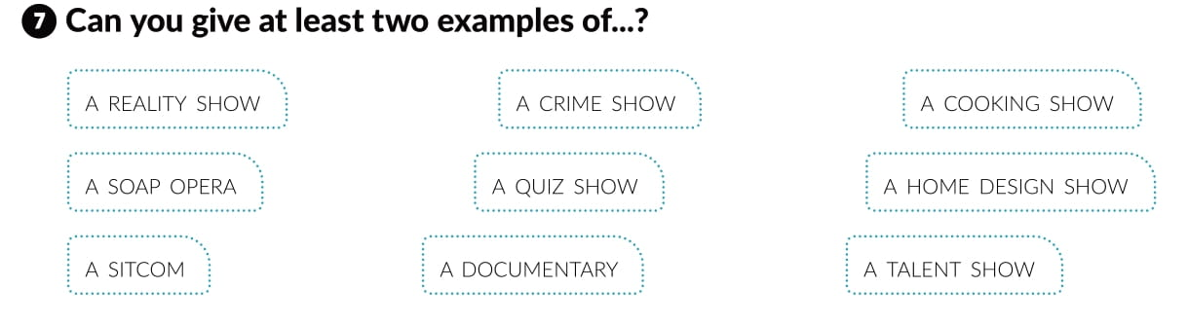

Slide 9
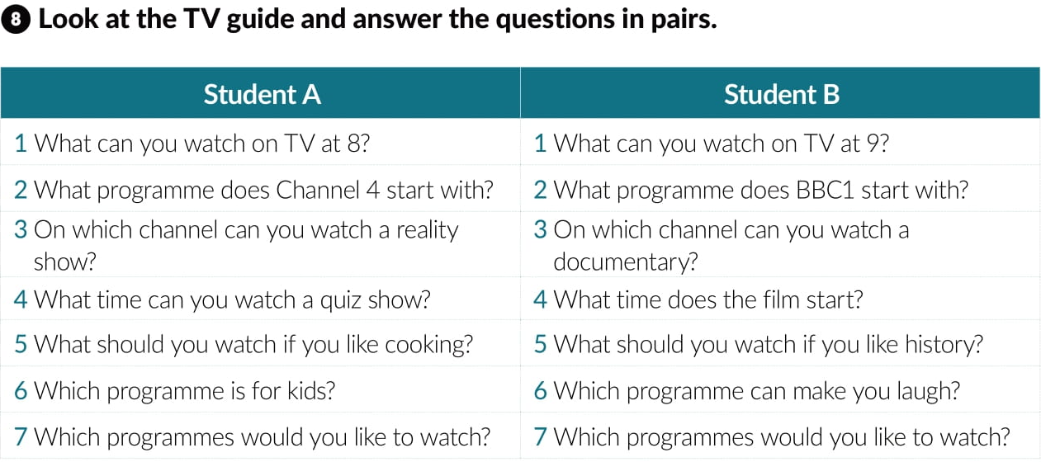

Slide 10
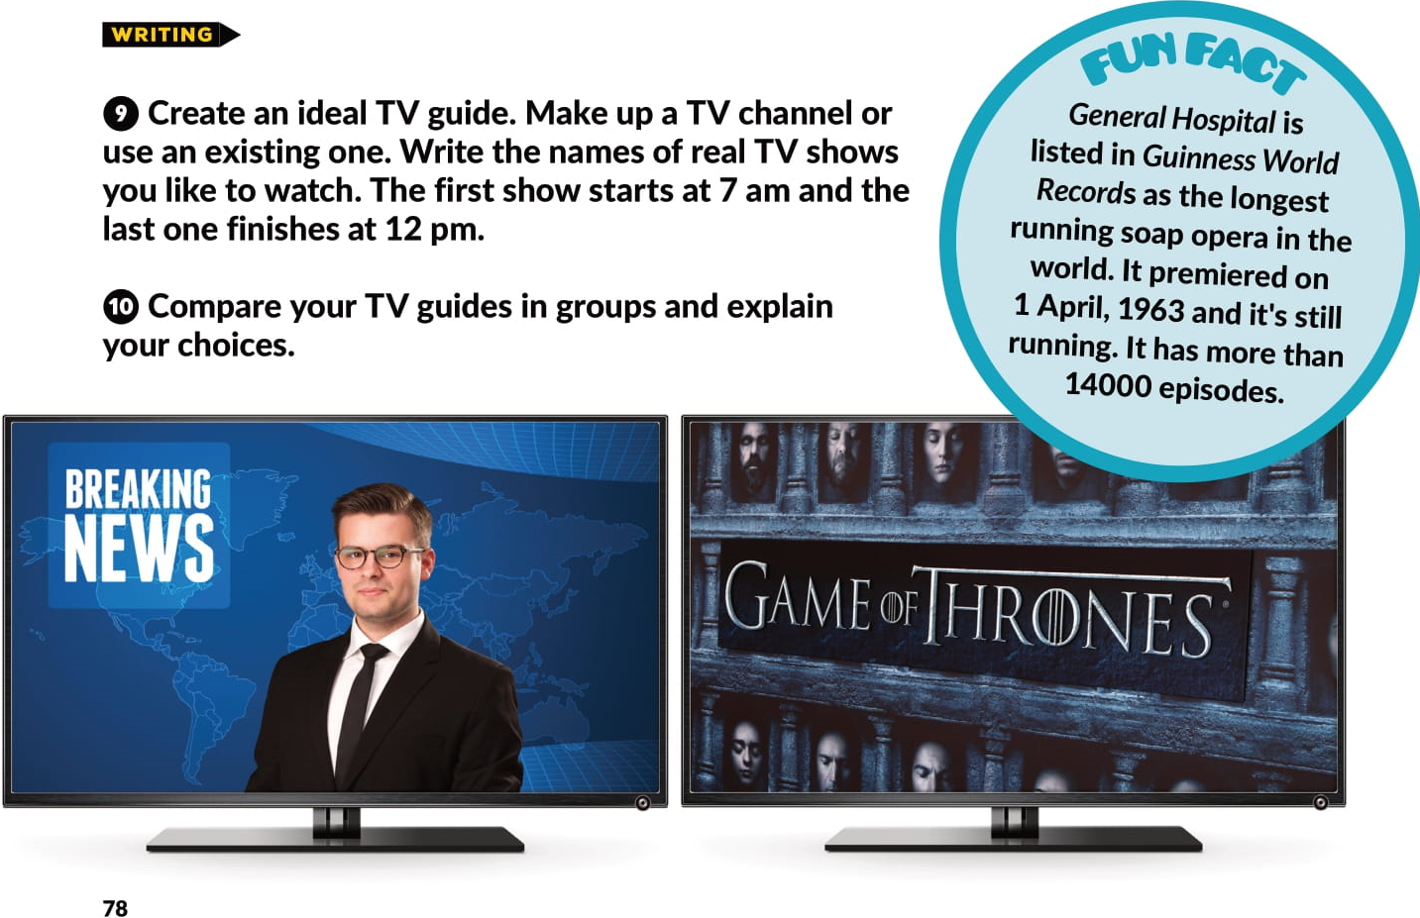

Slide 11
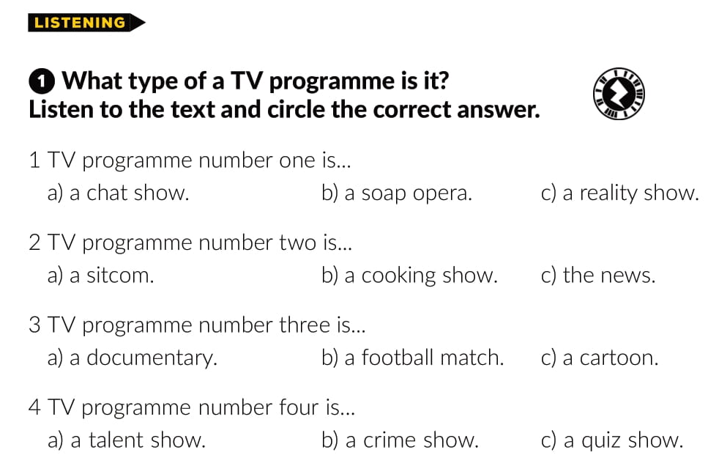



Slide 12
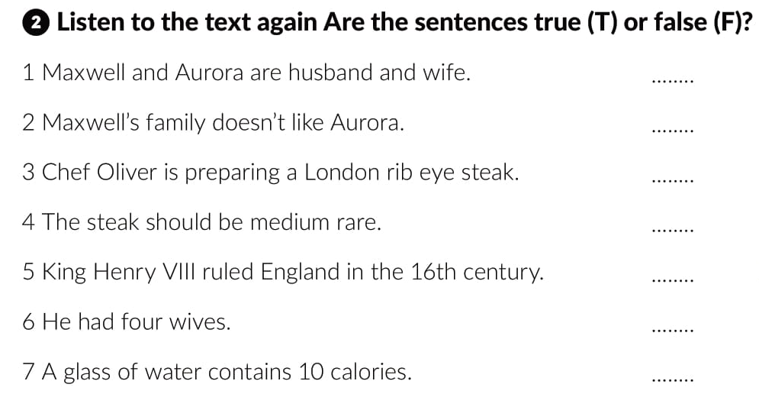
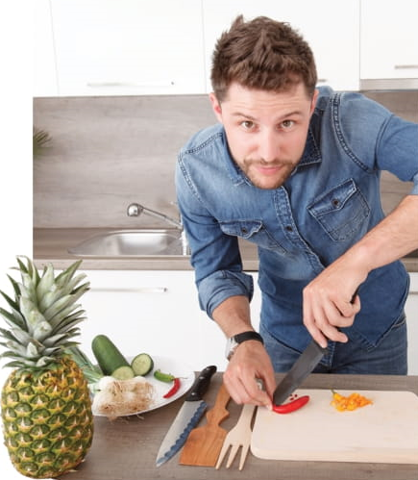
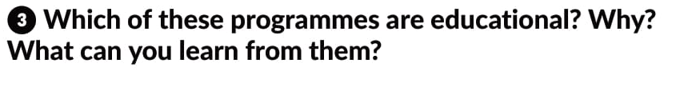
F
F
F
T
T
F
F

Slide 13
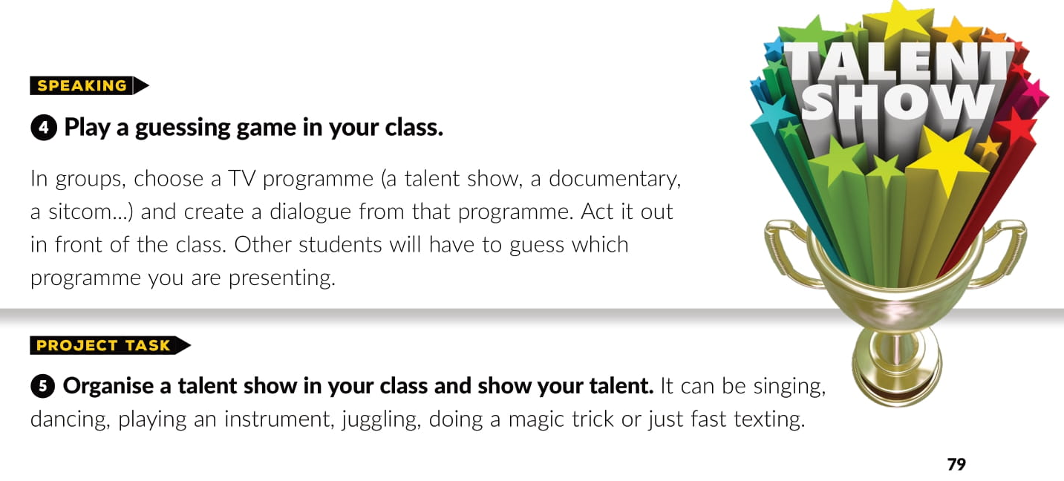

Slide 14
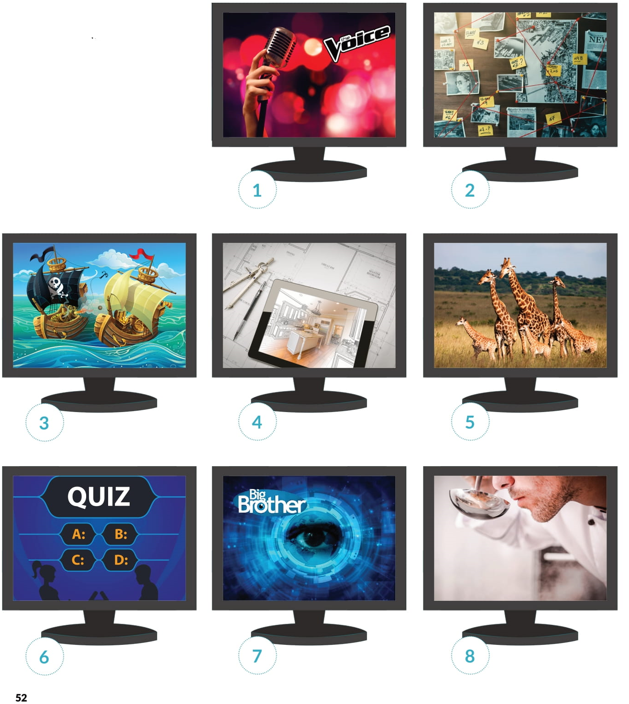

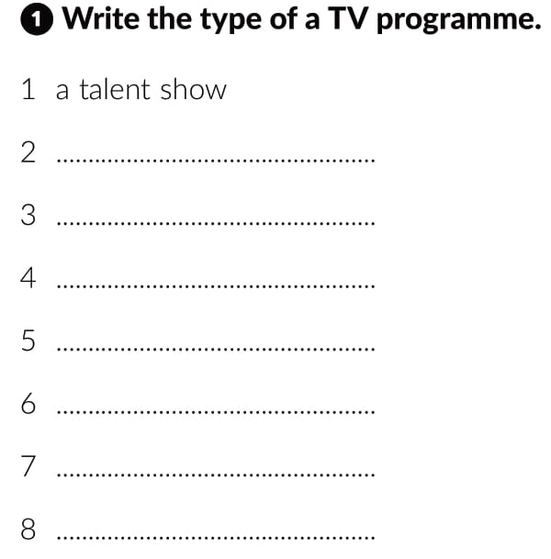
Workbook, page 52
a crime show
a cartoon
a home design show
a documentary about endangered species
a quiz show
a reality show
a cooking show

Slide 15
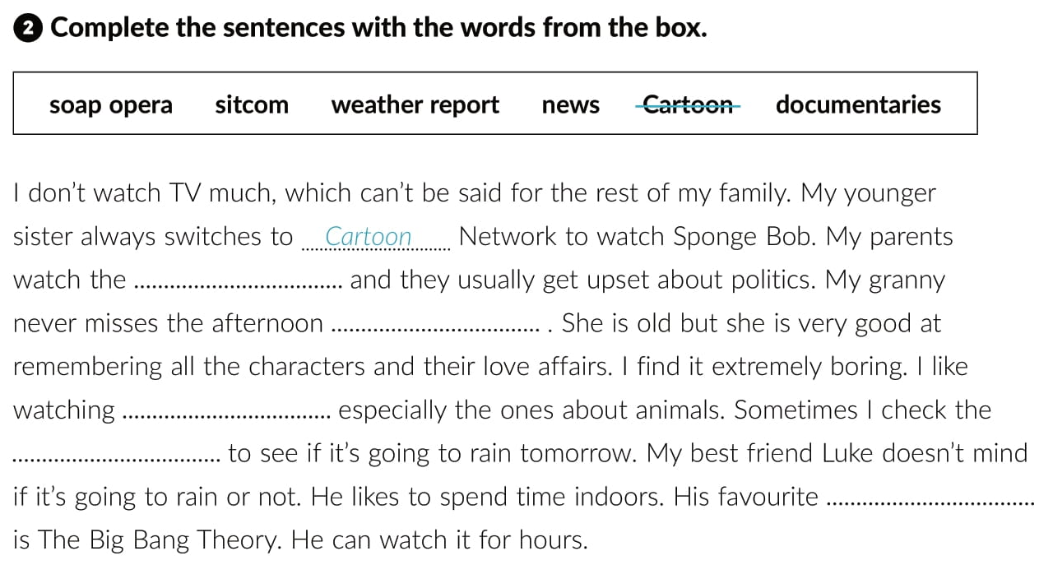
news
soap opera
documentaries
weather report
sitcom

Slide 16
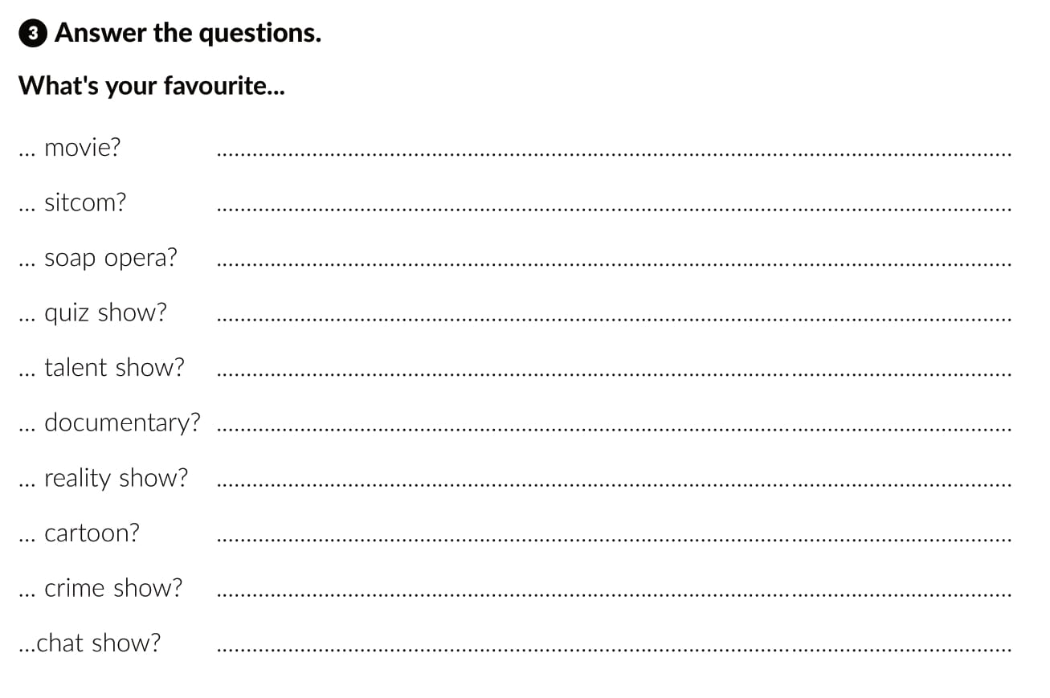

Slide 17
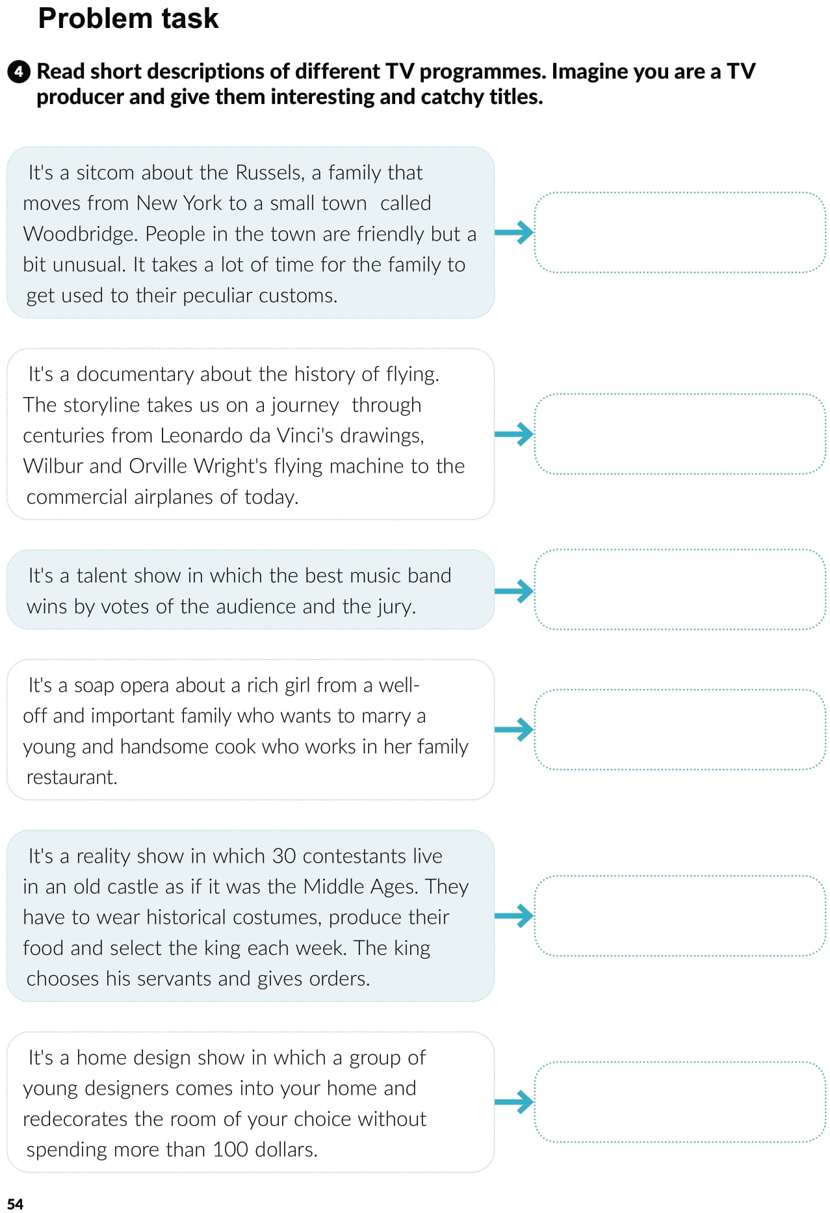


Slide 18

PLAY AND LEARN!
https://www.e-sfera.hr/dodatni-digitalni-sadrzaji/9c218fa1-5940-4604-921c-d254452407dc/

